Slide 1
Lane Following Robot
Notes:
this is not the technique we using

Slide 2
Let’s have fun with the Robot
>python manual_control.py

Slide 3
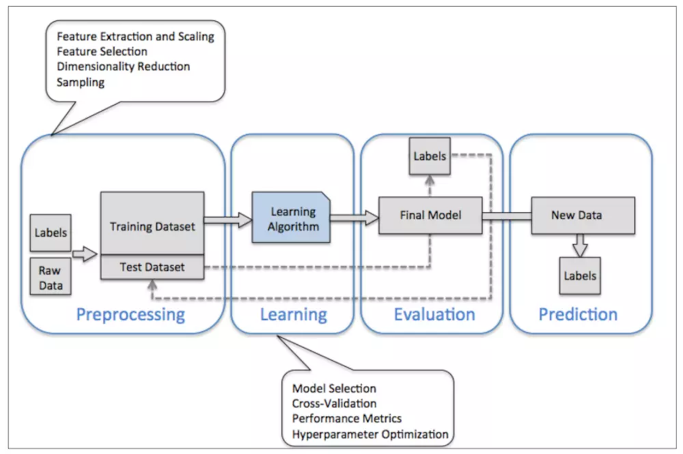
Typical Work Flow

Slide 4
Get Raw Data
>python data_collection.py
use spacebar to save the image
use backspace to change scene

Slide 5
Preprocessing and Train – Validation Split
>jupyter notebook
open training.ipynb

Slide 6
Train and Validation
…………………….............wait…………………………………..

Slide 7
Let’s AI drive the car
>python have_fun.py

Slide 8
Let’s change the environments
>python have_fun.py –map-name udem1
4way
straight_road
zigzag_dists
loop_obstacles
loop_pedestrains
double dash

Slide 9
Any Questions?

Slide 10
My Questions:
Q1: What is the different between virtual world and real environment?
Q2: What is the benefit of testing in virtual world?
Q3: What happen when you change the environments? Why it happen?
Q4: What happen if you directly transfer the prediction model to a real robot?
Q5: What are the different between session 1 and session 2?
Notes:
Q1 – Wind, friction, machine breakdown, Sun Light
Q2 – cost effective, faster setup
Q3 – it not work, scene is different, just like push some one don’t know how to swim into the pool
Q4 – it fail.
Q5 –
hand craft rules – you know what happen and why it fail
- time spent on feature searching (signal vs action)
deep learning – you create a black box
- time spent on training
Conclusion – there are both advantage and disadvantage.

